Slide 1
DBMS OF CAR SHOWROOM
DBMS of car showroom
Erkanat Abdul-Madi
Astana IT University
SE-2002
Educational Practice
Aidana Kalakova
(Instructor)

Slide 2
Outline
INTRODUCTION
ERD of DBMS
Code of tables and columns
Result of cods
Problems during work and use DDL and DML statements
The final table

Slide 3
INTRODUCTION
A car showroom is a place where cars are sold, stored and serviced, all for customers who want to make the right choice.
This DBMS consists of different tables and includes only the structure of the car showroom.

Slide 4
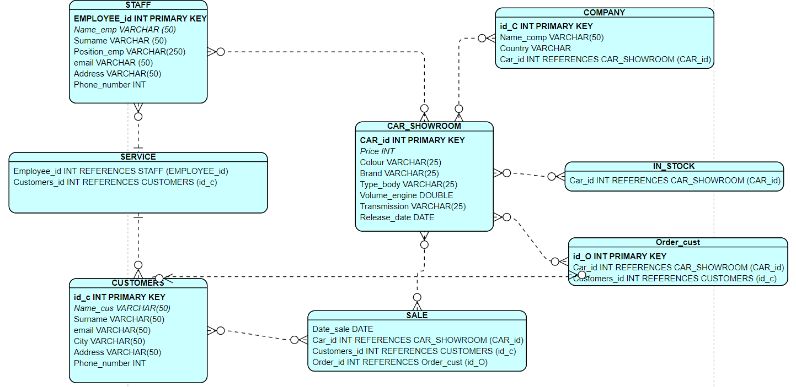
ERD of DBMS

Slide 5
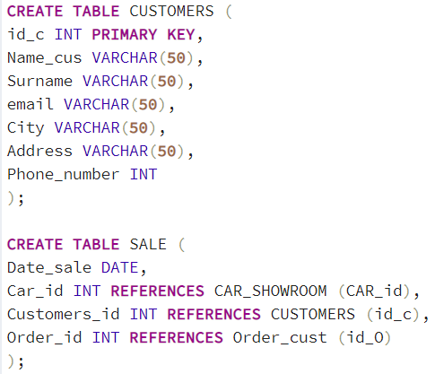
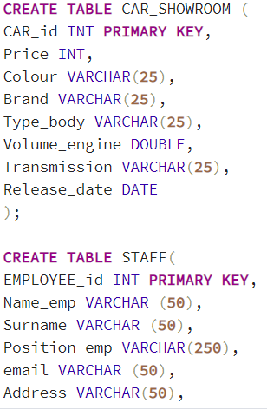
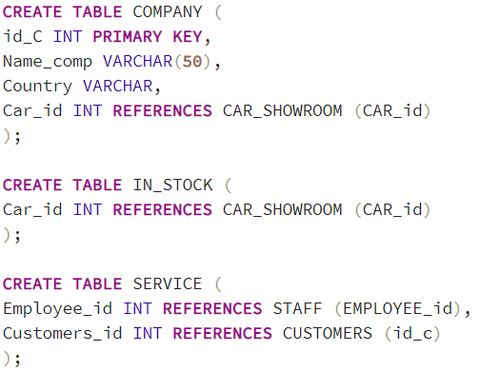
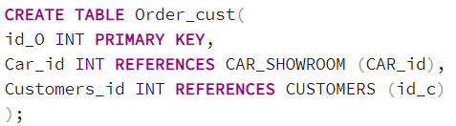
Code of tables and columns

Slide 6



Result of cods

Slide 7
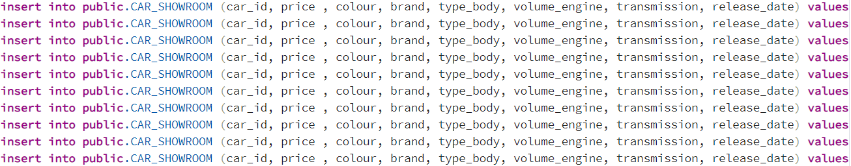
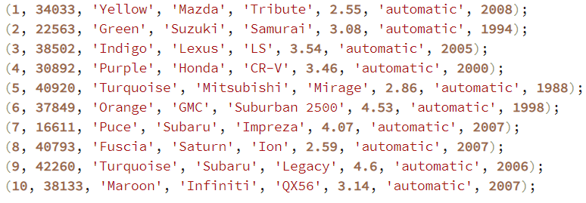
Problems during work and use DDL and DML statements

Slide 8
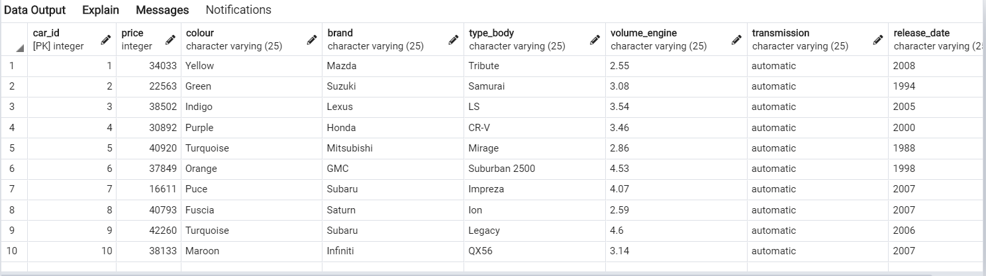
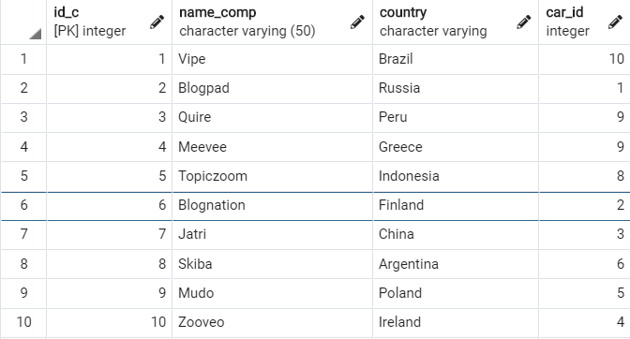
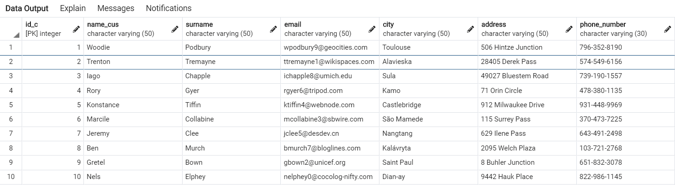
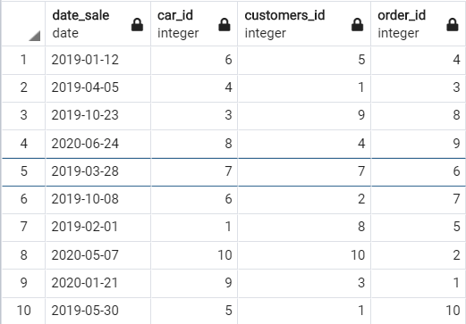
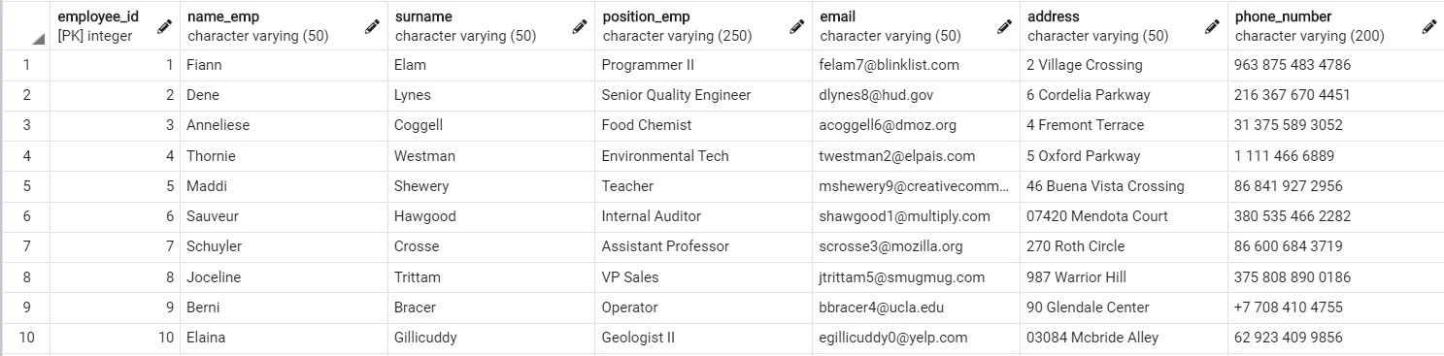

Slide 9
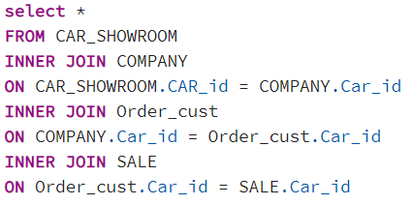

Slide 10
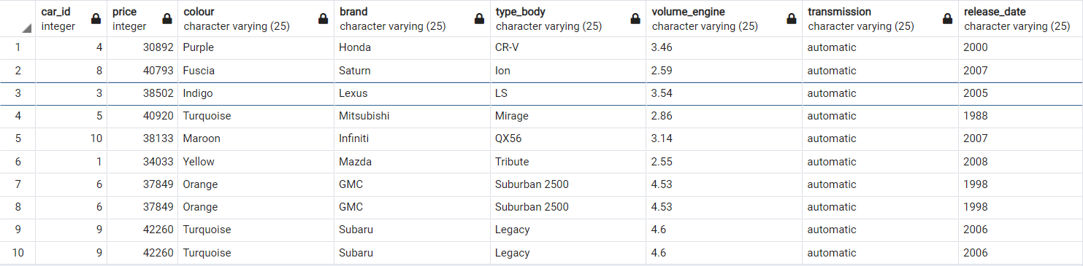
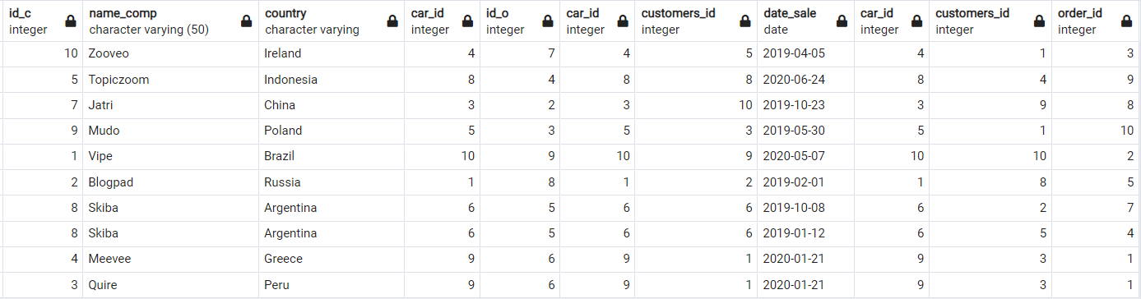
The final table

Slide 11


